Slide 1
Computer Graphics
GEOMETRY & TRANSFORMATIONS
(UNIT 3)
DR. PALLAVI PRATAP

Slide 2
Types of Transformations
*Translation
*Scaling
*Rotation
*Reflection
*Shearing

Slide 3
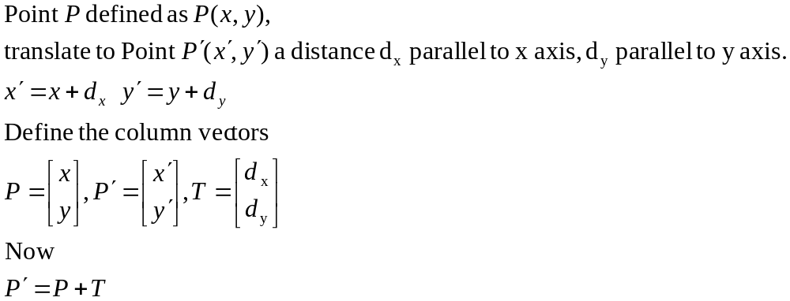
2D Translations.
P’
P

Slide 4
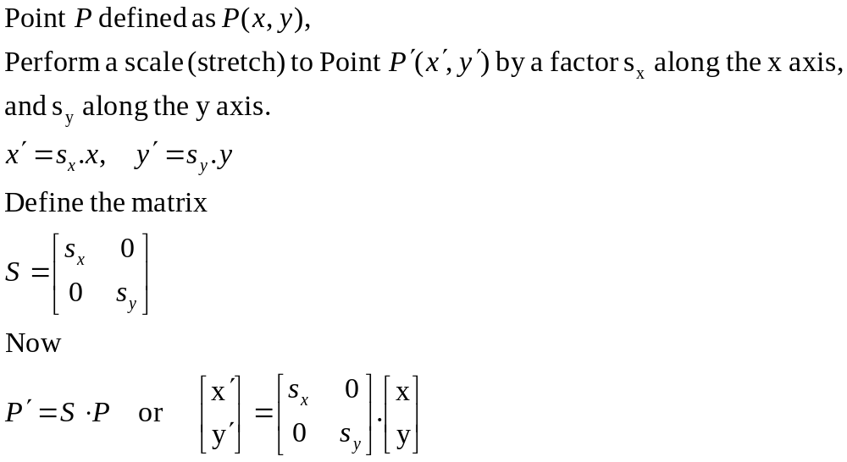
2D Scaling from the origin.
P’
P

Slide 5
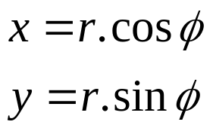
2D Rotation about the origin.
y
P’(x’,y’)
P(x,y)
r
θ
y
φ
r
x
x

Slide 6
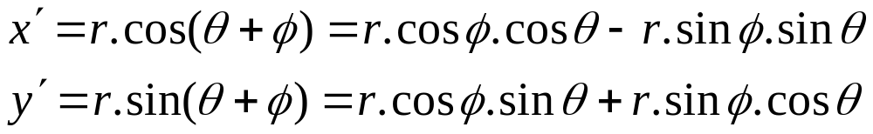
2D Rotation about the origin.
y
P’(x’,y’)
P(x,y)
r
θ
y
φ
r
x
x

Slide 7
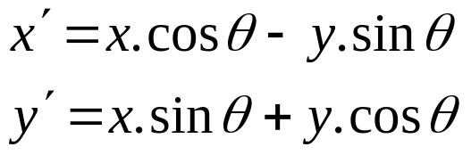
2D Rotation about the origin.
Substituting for r :
Gives us :

Slide 8
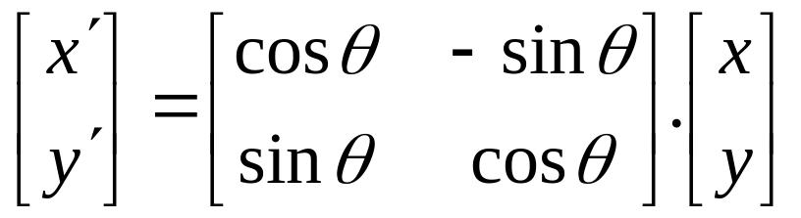
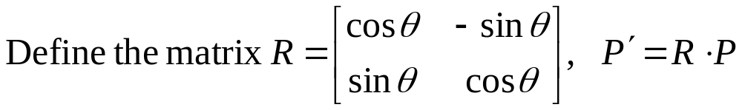
2D Rotation about the origin.
Rewriting in matrix form gives us :

Slide 9
Transformations.
Translation.
  P′=T + P
Scale
  P′=S ⋅ P
Rotation
  P′=R ⋅ P
We would like all transformations to be multiplications so we can concatenate them ⇒ express points in homogenous coordinates.

Slide 10
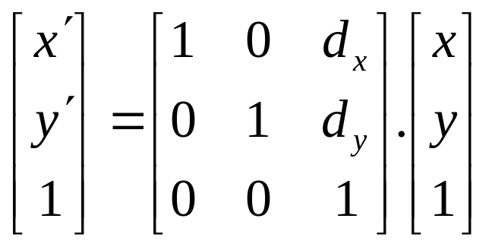
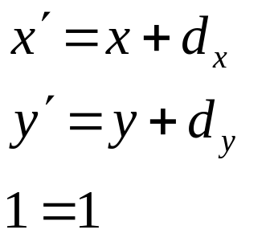
Translations in homogenised coordinates
Transformation matrices for 2D translation are now 3x3.

Slide 11
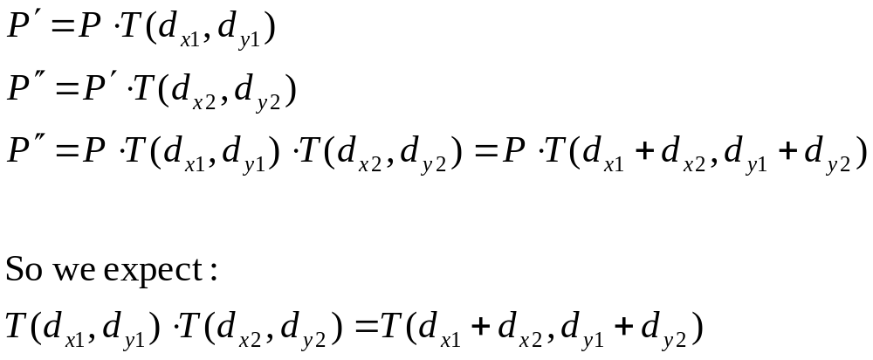
Concatenation.
We perform 2 translations on the same point:

Slide 12
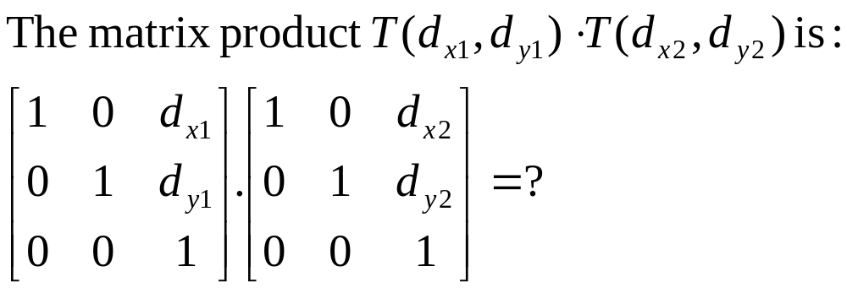
Concatenation.
Matrix product is variously referred to as compounding, concatenation, or composition

Slide 13
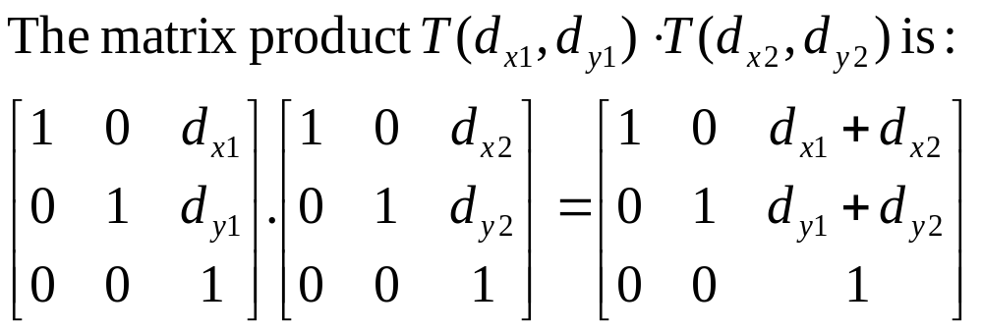
Concatenation.
Matrix product is variously referred to as compounding, concatenation, or composition.
This single matrix is called the Coordinate Transformation Matrix or CTM.

Slide 14
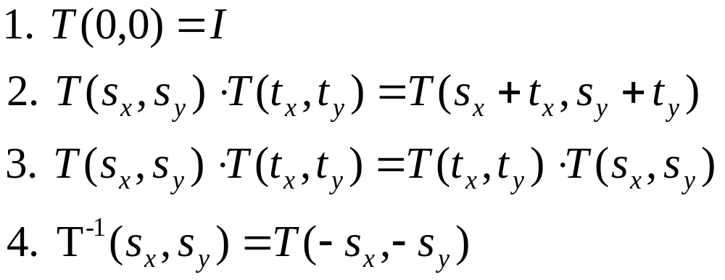
Properties of translations.
Note : 3. translation matrices are commutative.

Slide 15
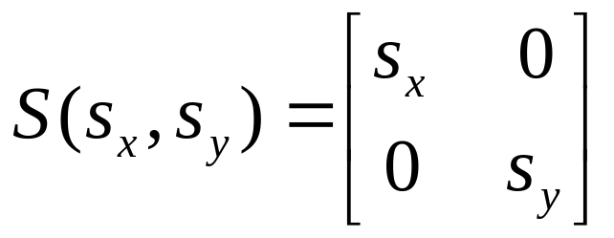
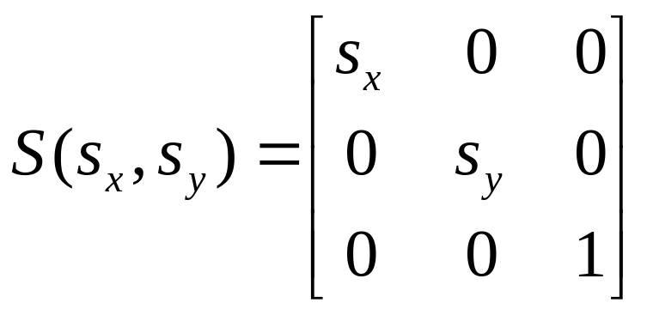
Homogeneous form of scale.
Recall the (x,y) form of Scale :
In homogeneous coordinates :

Slide 16
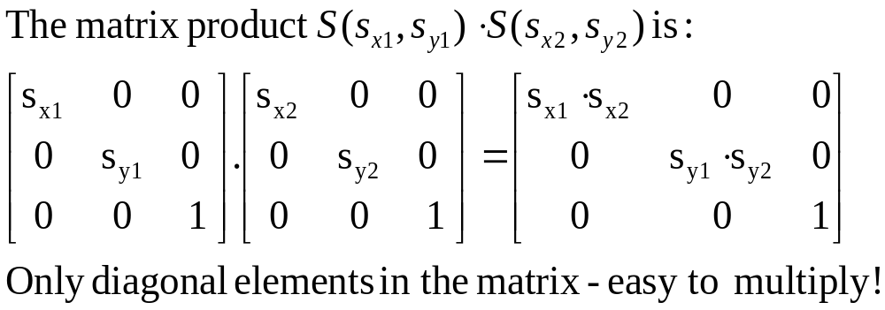
Concatenation of scales.

Slide 17
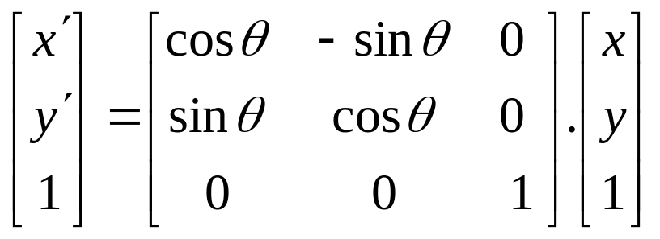
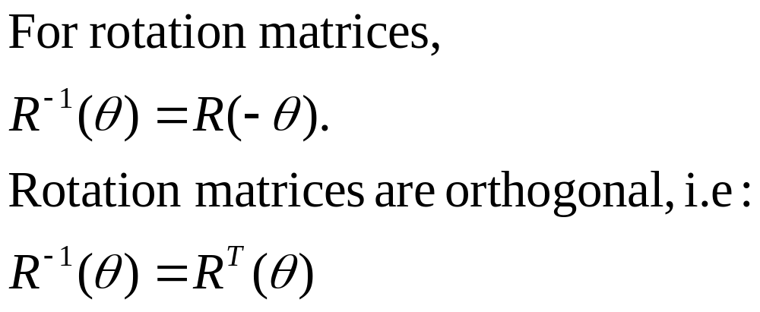
Homogeneous form of rotation.

Slide 18
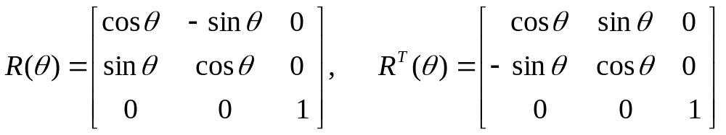
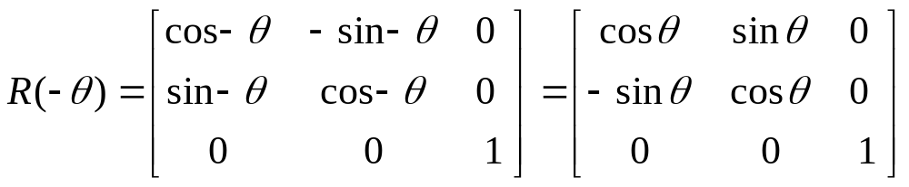
Orthogonality of rotation matrices.

Slide 19
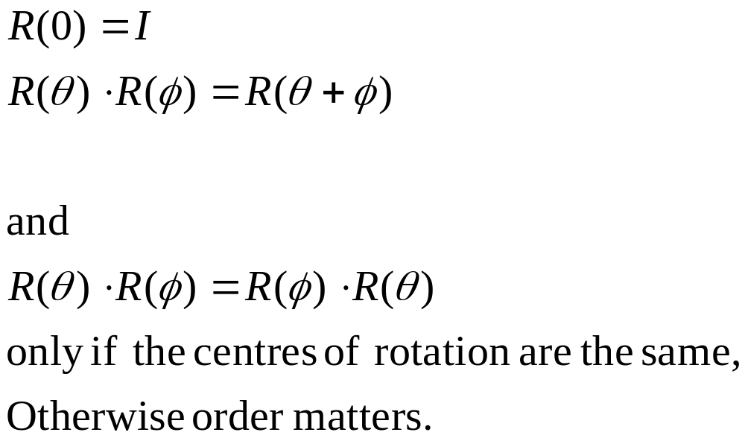
Other properties of rotation.

